Slide 1

HOW BLOCKCHAIN TECHNOLOGY
WILL CHANGE EVERYTHING
Martin Ruubel, Vice Chairman, ECSO
March 2017

Slide 2
EUROPEAN UNION AND
CHALLENGES IN CYBERSECURITY
2
28 Member States, 25% of world’s economy, built over past 50 years
Free movement of people, goods, services, and capital
Common external (cyber)security threats
Uneven level of cyber experience and knowhow
Complicated and slow decision-making process
No automatic trust between the Member States
HOW TO HARNESS COMBINED
EUROPEAN STRENGTHS TO PERSEVERE AND SUCCEED IN CYBER?

Slide 3
WHAT IS ECSO?
3
WHAT IS IT:
ECSO was founded in June 2016 and represents an industry-led contractual counterpart to the European Commission for the implementation of the Cyber Security contractual Public-Private Partnership (cPPP).
MEMBERS:
Over 200 large companies, SMEs and start-ups, research centres, universities, end-users, operators, clusters and association as well as European Member State’s local, regional and national administrations, countries part of the European Economic Area (EEA) and the European Free Trade Association (EFTA)
GOALS:
Foster the growth of the European Digital Single Market and protect it from cyber threats ;
Develop the cybersecurity market in Europe and the growth of a competitive cybersecurity and ICT industry, with an increased market position;
Develop and implement cybersecurity solutions for the critical steps of trusted supply chains, in sectoral applications where Europe is a leader.
BLOCKCHAIN IS FRONT AND CENTER OF EUROPEAN CYBER AGENDA

Slide 4
4
BLOCKCHAIN:
SIGNIFICANCE, CHALLENGES
AND BEST PRACTICES

Slide 5


SIGNIFICANCE OF
BLOCKCHAIN TECHNOLOGY
5
There is a massive promise and excitement for a blockchain technology because of its’s many potential benefits:
Trustless exchange
Empowered users
High quality data
Data immutability
Process integrity
Ecosystem simplification

Slide 6
BLOCKCHAIN POTENTIAL
IN DIFFERENT INDUSTRIES
6
Financial Institutions | Corporates | Governments | Cross-Industry
Peer-to-peer transactions | Supply chain management | Record management | Cybersecurity
International payments | Healthcare | Tax collection | Big Data
Capital markets | Real estate | Identity management | IoT
Trade finance | Media | Voting | Data storage and archiving
Regulatory compliance & audit | Energy | Law enforcement | Accounting
KYC - AML | Automotive | Legislation, compliance and regulatory oversight | Shareholder voting
Insurance | Agriculture | Government resilience | Etc.…

Slide 7


CURRENT CHALLENGES
IN BLOCKCHAIN IMPLEMENTATION
7
However, there are also massive constraints for actually implementing the blockchains:
Nascent technology
Scalability issues
Security concerns
Regulatory implications
Legacy interoperability
Cost considerations

Slide 8
TRADITIONAL BLOCKCHAIN
TECHNOLOGY STACK
8
Widely Witnessed Integrity
Blockchain
Storage
Consensus Based Ledger
Process
Universal Business Logic Scripting
Integral technology
One-size fits all
Self organizing
Public

Slide 9
REALISTIC BLOCKCHAIN
TECHNOLOGY STACK
9
Legacy
system
Data and Systems Integrity
Data Origin
Data Provenance
Widely Witnessed Integrity
i.e. Guardtime’s KSI Blockchain
Public
No data on blockchain
Optimized for scale
High frequency
Storage
Hyperledger
Storage
KSI Ledger
Storage
Ledger #3
Storage
Ledger #4
Ad-hoc storage schema
Public or private, mix
Separate consensus
Process
KSI Contracts
Process
Scriplets
Process
Haskell
Process
Hardcoded Logic
Ad-hoc business rules
Public or private, mix
Easy to formally verify

Slide 10
10
RECAP:
MUST-HAVE CHARACTERISTICS OF
TODAY’S BLOCKCHAIN TECHNOLOGY STACK

Slide 11

11
SCALE
in order for the blockchain to be able to provide immutability for petabytes of data - no data should be stored on the blockchain itself!

Slide 12
12
FLEXIBILITY
The blockchain should be data storage agnostic. Each blockchain user should be free to use legacy systems or implement new services based on the appropriate ledger technologies – Hyperledger, KSI Ledger, Ethereum, etc.

Slide 13

13
PERFORMANCE
The blockchain should have a known and constant registration time and a verification time of less than 100 milliseconds. The lessons learned from live production systems tell us that speed is essential for user experience.

Slide 14

14
SECURITY
The blockchain cryptosystem must have a peer reviewed formal security proof - it’s security must not depend on external processes.

Slide 15

15
LEGACY
The blockchain must work with legacy systems. It must be possible to take a phased approach to blockchain implementation – integrate legacy systems with blockchain, then build new ledger based processes as necessary.

Slide 16
16
RELIABILITY
The blockchain must provide telecom grade service. It must be guaranteed to work with 99.999% availability, resistant to denial of service attacks and proven to continue to function even under constant attack.
16

Slide 17
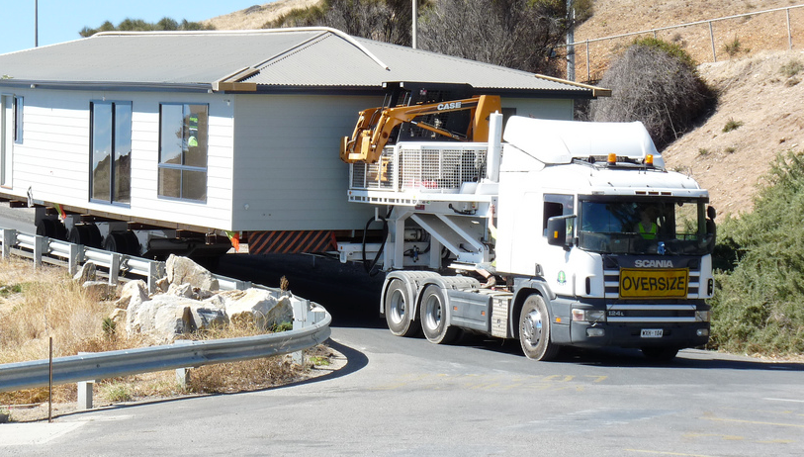
13
PORTABILITY
It must be possible to take the data out of one ledger system and use it elsewhere – immutable data must be portable across systems and services.

Slide 18
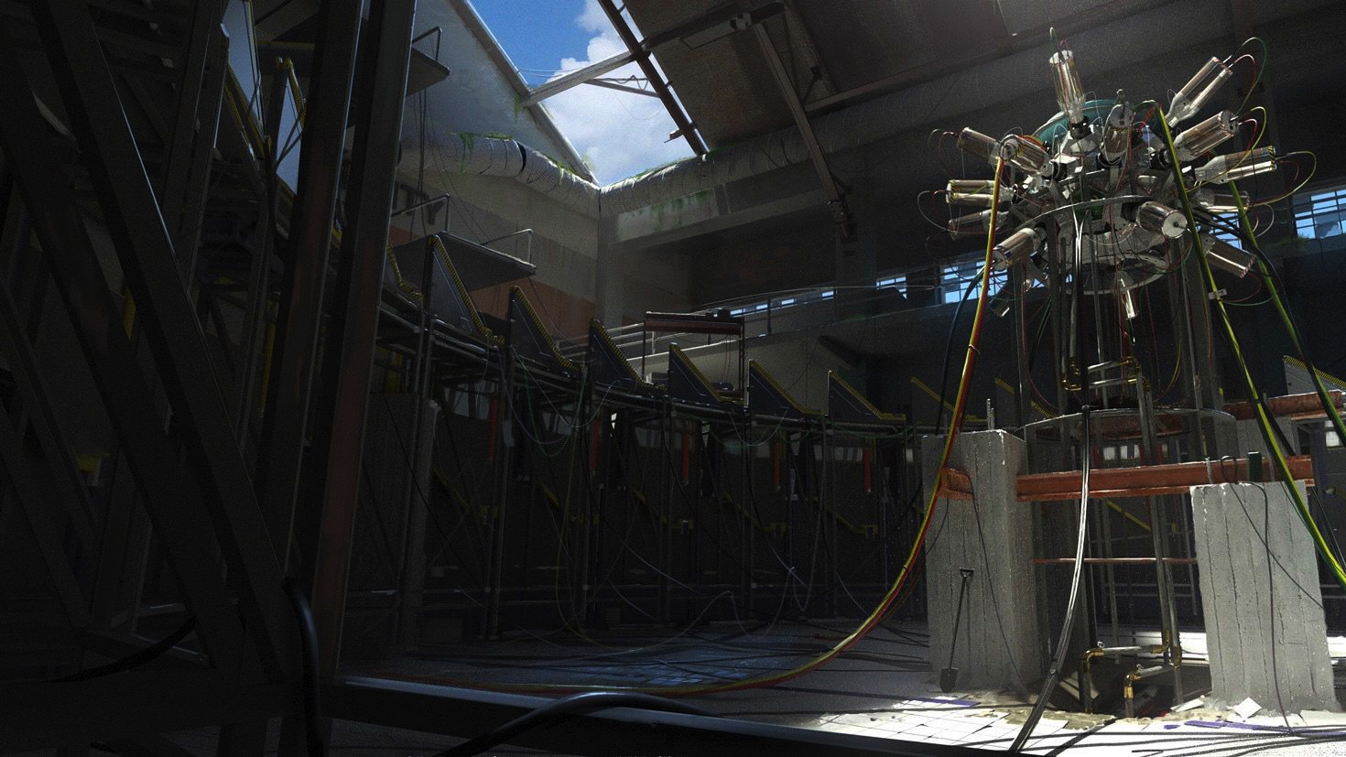
17
FUTURE PROOF
The cryptography behind the technology should be able to withstand attacks by tomorrow’s quantum computers.
18

Slide 19
18
BLOCKCHAIN:
SELECTED ENTERPRISE USE CASES

Slide 20
BLOCKCHAIN USE CASES
COMPLIANCE
19
Blockchain technology provides fundamental means to independently tag, track, locate and authenticate the state of digital assets, regardless of the asset’s type, location or scale, without revealing the underlying data.
This capability has never been possible before.
Without putting excessive burden to the regulators or subjects of the regulations, Blockchain integration enables to achieve verifiable self-certification and:
Assure compliance with KYC / AML rules
Assure compliance with Data Residency rules.
Assure compliance with Privacy rules
Independently audit Service Provider behaviors.
BLOCKCHAIN

Slide 21

BLOCKCHAIN USE CASES
HEALTHCARE AND PATIENT RECORDS
20
v
KSI BLOCKCHAIN
PLUG-IN
DATABASE RECORD
HASH
HASH
DATABASE RECORD
HASH
HASH
DATABASE RECORD
HASH
HASH
DATABASE RECORD
HASH
HASH
SIGNATURE
DATABASE RECORD
HASH
HASH
BLOCKCHAIN
DATABASE RECORD
HASH
HASH
DATABASE RECORD
HASH
HASH
DATABASE RECORD
HASH
AUDIT LOG

Slide 22
HEALTHCARE AND PATIENT RECORDS
BENEFITS
21
Blockchain solves several key problems for healthcare record storage:
1
How to discover unauthorized changes, also those made by the insiders, and report them in a timely fashion.
2
How to produce independent and legally sound proof of record for internal, external and regulatory compliance purposes.
3
How to achieve the above capabilities at scale across extremely large systems with petabytes of data and (hundreds of) millions of records

Slide 23
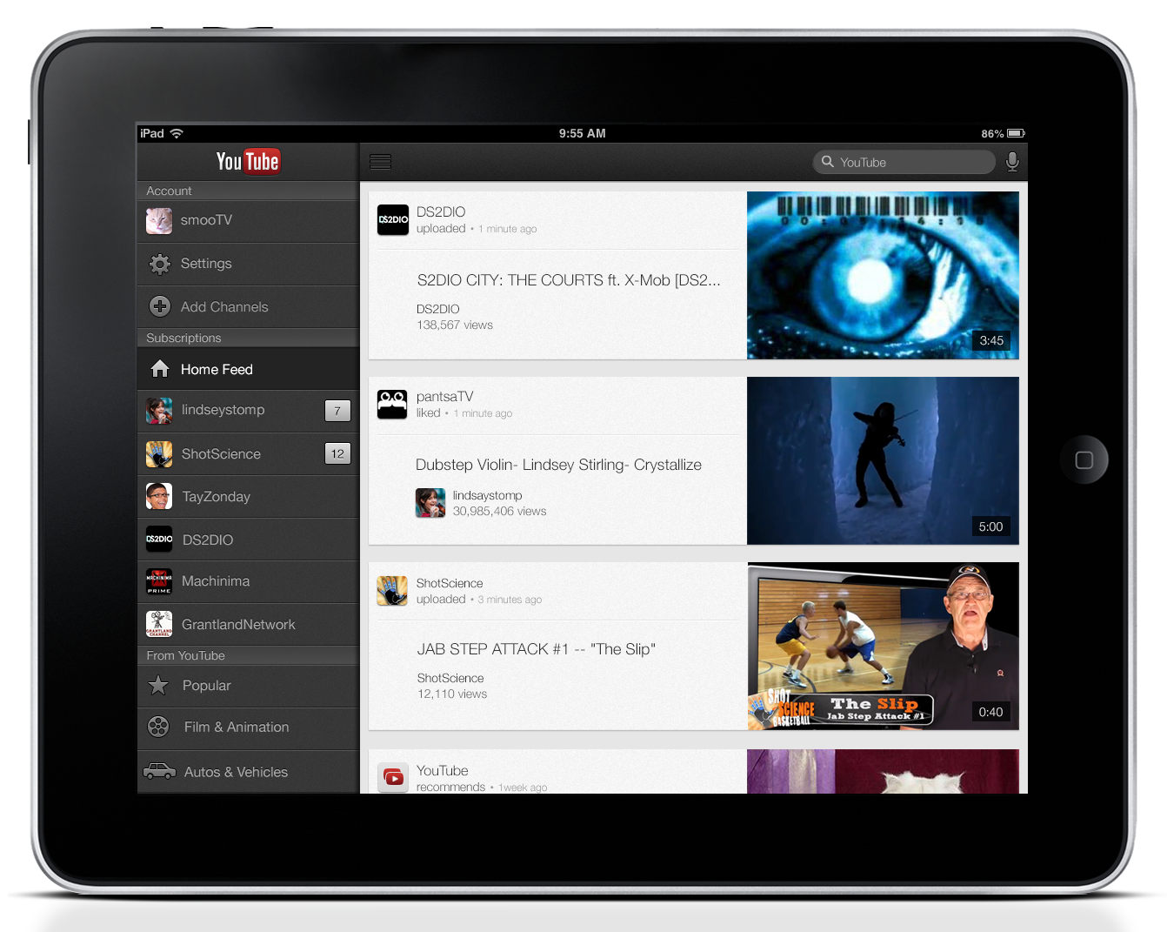
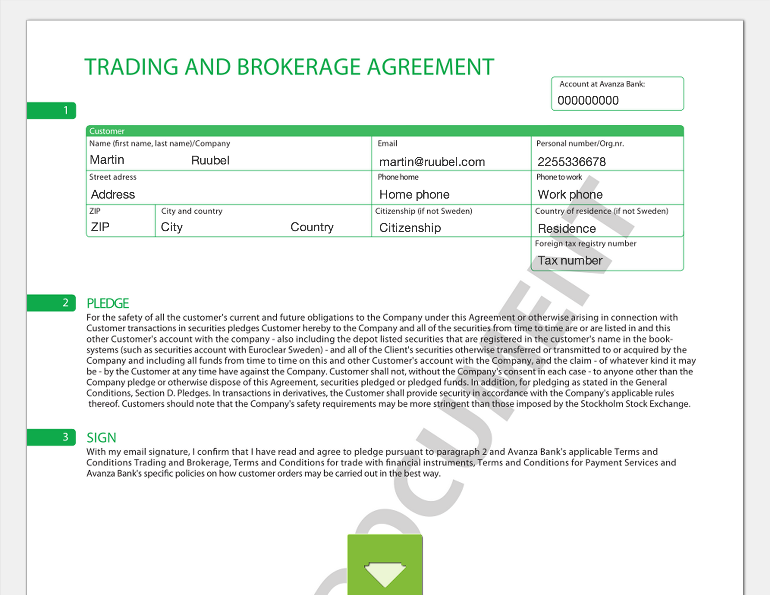
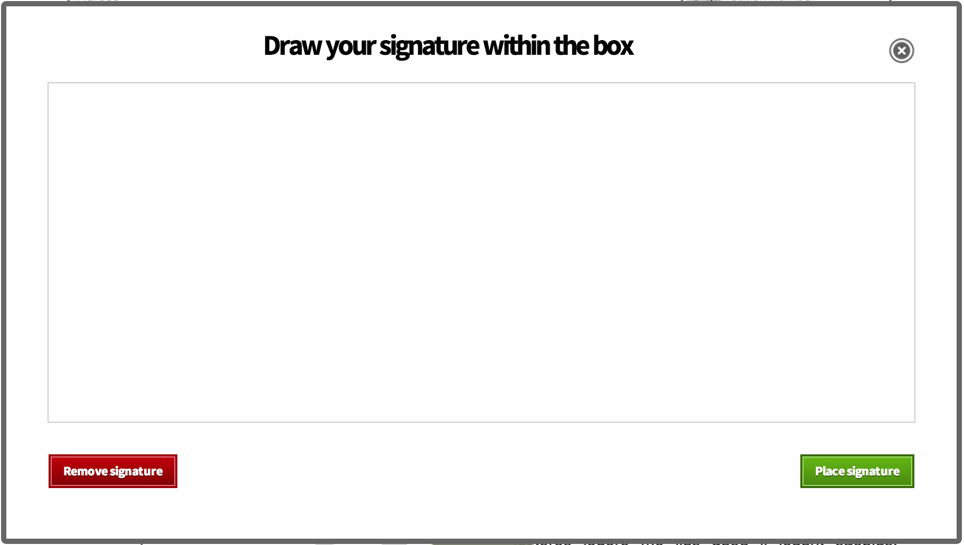

BLOCKCHAIN USE CASES
CLIENT ONBOARDING
22
Scrive is a Swedish company that provides a technology for rapid client onboarding that requires a signing authority.
Solution Benefits:
30% increased conversion when compared to sending paper
Strong non repudiation for signed documents lasting over required 10 years.
Contract integrity is independently verifiable by Scrive customers with no third-party involvement.

Slide 24
BLOCKCHAIN USE CASES
ENTERPRISE CYBERSECURITY
23
Blockchain based Enterprise Cybersecurity solution is based on continuous verification of the integrity state of Enterprise network, digital assets and data.
By collecting, analyzing, correlating and reporting this evidence one can build an integrity snapshot of the network and important digital repositories and archives.
Any unauthorized change in the integrity state represents an attack, whether internal or external, and can be detected with 100% certainty and accuracy.

Slide 25
ENTERPRISE CYBERSECURITY
BENEFITS
24
Real-Time Incident Response. It is impossible for an external attacker or an inside threat actor to hide their activities for weeks and months by erasing their traces. Ericsson Cybersecurity Solution continuously monitors the critical components of the network and digital assets and alerts when any unautorized change is detected.
Full Situational Awareness. Ericsson Cybersecurity Solution does not search for vulnerabilities like traditional cybersecurity platforms. Instead, it continuously verifies whether the network and digital assets are in authorized clean state, with any deviation representing a possible security breach that can be acted upon. You can prove at any point of time whether your network is secure, and if not, where exactly the compromise originates from.
Insider-Threat Mitigation. Ericsson Cybersecurity Solution is not vulnerable for privileged Insider-Threat Actors, the solution uses KSI signature technology from Guardtime that uses formal mathematical methods only for data integrity, time and attribute of origin verification and that unconditionally cannot be manipulated by anyone or anything.

Slide 26
25
SUMMARY:
RECOMMENDATION
FOR BLOCKCHAIN IMPLEMENTATION
BASED ON EUROPEAN EXPERIENCE

Slide 27

WHAT TO LOOK FOR WHEN
STARTING TO IMPLEMENT BLOCKCHAIN
26
Based on lessons learned from Estonia, Finland, Netherlands, UK and other European countries, we have learned that governments look for:
Incremental implementation
Integrity as the first use case
Data out of blockchain
Ad-hoc ledgers and process logic
Formal security proofs
Objective evaluation of blockchain technologies for their performance, flexibility and security is crucial!

Slide 28

CONTACT US
European Cyber Security Organisation
10, Rue Montoyer
1000 – Brussels – BELGIUM
www.ecs-org.eu
Phone:
+32 (0) 27770256
E-mail:
Ms. Eda Aygen
Head of Communications & Advisor to the Board
eda.aygen@ecs-org.eu
Follow us
Twitter: @ecso_eu

